Slide 1
Conway’s Game of Life
A Haskell Implementation

Slide 2
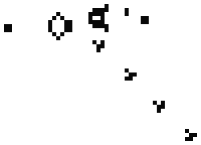
What and Why?
Simple cell automaton simulation.
A dead cell with 3 neighbors comes alive
A living cell with 2 or 3 neighbors stays alive
All other cases the cell is dead
Two different “implementations”.
I wanted to make something cool and new that was fun to make and fun to play with
I was hoping to learn about how to control the terminal with Haskell, do user IO better, and get a better grasp of Haskell in general

Slide 3
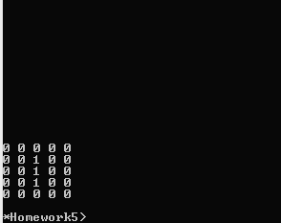
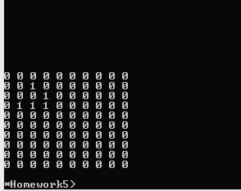
Step 1: The logic
The base logic for this project was pretty straight forward:
Generate a field of Cells
Compute number of living cells
Apply required changes to new field
Print
Turned out to be much easier then I anticipated
Had a lot of problems with original code

Slide 4
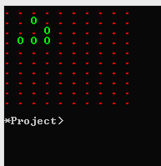
Step 2: Making it pretty
After the first part I assumed this would be easy
I was wrong.
Required me to learn Console.ANSI, and do a bunch of strange iterative logic (ugly!)
Was even more inefficient with drawing and hard to look at.
Was and improvement but still needed work.

Slide 5
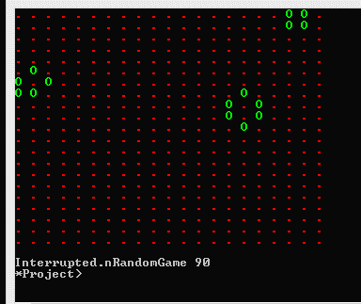
Step 3: Being random
Testing new additions was starting to become boring (same field every time).
Hardcoding fields was also not something I wanted.
I added random generated fields.
This was very difficult as my concept of random generation, clashed with Haskell
Using IO for random.
Was really strange, but I understand after-the-fact

Slide 6
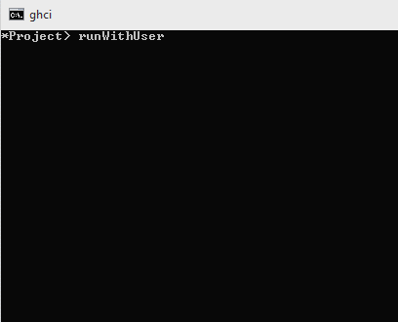
Step 5: Actually usable!
This was probably the hardest step due to what I had to learn
Ncurses doesn’t work,
Console.ANSI can’t do input
Finally resorted to Haskeline (worked great)
Had to re-write main driving functions to accommodate IO so that user input could be taken
Also finally re-did how drawing happened so it wasn’t painful to look at.
The code is a giant mess at this point

Slide 7
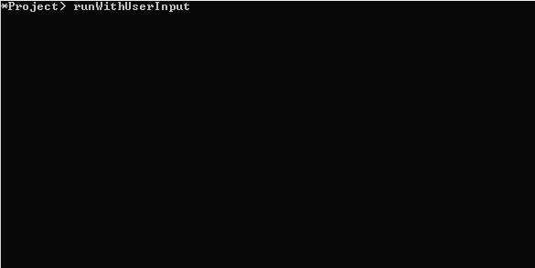
Step 6: Purification
At this point code cleanup was the major goal
During this process I ran into and fixed a significant amount of bugs (how did it even work before?)
I also improved how user input is handled to something that works well and actually makes sense.
Finally I improved drawing a bit resulting in the final solid product.

Slide 8
What I learned
Generating random numbers is hard
Doing user input is harder
Doing actual logic was really easy
Haskell and my brain don’t mash together well

